Slide 1
Modeling Foundations
Review of (a small part of) ANLY-512

Slide 2
Major Topics
Predictive modeling concepts and foundations
Unsupervised and supervised learning
Classification and regression
Model Evaluation
Model Selection & Cross Validation
Bias Variance Tradeoff
Accuracy-Interpretability
Linear Methods

Slide 3
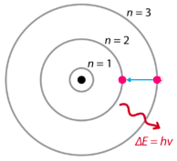
Predictive Modeling
A model is a mathematical toy that helps us either (i) understand the world around us or (ii) predict the world around us or (iii) ideally both.
Q: What is example of a model in the Natural Sciences? In the Social Sciences? How are these similar or different (in their goals) than some of the modeling techniques in Machine Learning?
We’ve gone out in the world and made observations, we’ve gathered data. How can we use this data to be smarter in the future?

Slide 4
Predictive Modeling - Terminology
We aim to understand (or at least approximate) the relationships between some input variables and some output variables
Features
Predictors
Regressions
Inputs
Independent Variables
Variables
X
Targets
Target Variables
Y
X
F(X)
Y

Slide 5

Predictive Modeling - Terminology
X
F(X)
Y
The true data-generating process F(X) is unknown to us. All we can do is create a family of functions f(X) which we hope can approximate the true F(X).

Slide 6



Predictive Modeling - Terminology
X
F(X)
Y
After we have fit our model to a particular set of observations, we have a single estimator . From this we can make our best-guess predictions , for any previously observed X but also any yet-unseen X.

Slide 7
Predictive Modeling - Terminology
Concrete Example: Suppose we want to predict someone’s income from their age, education, gender, birthplace,...
Question: What is one modeling technique we could use here?
Question: What is the family of functions that is accessible by this model?
Question: Is it possible that the true relationship that explains income is not accessible by our model?

Slide 8
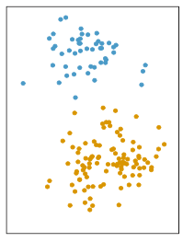
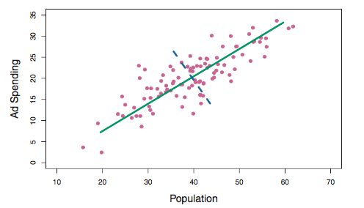
Unsupervised Learning
When we have no explicit target variable Y, we simply have data X and are interested in understanding the structure and patterns.
Clustering
Principal Component Analysis

Slide 9
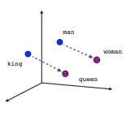
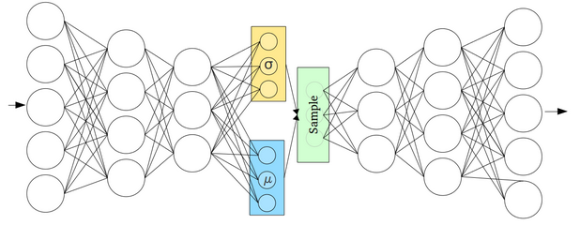
Unsupervised Learning
When we have no explicit target variable Y, we simply have data X and are interested in understanding the structure and patterns.
Dense Embeddings
Autoencoders

Slide 10
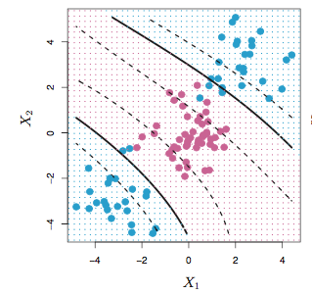
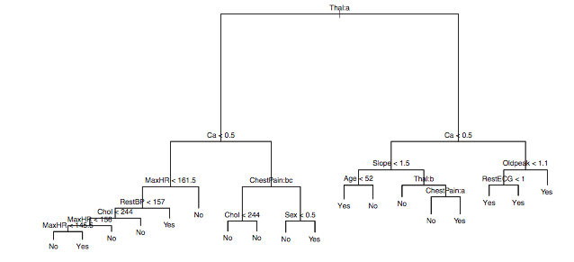
Supervised Learning
We want to predict target Y from predictors X (Classification and Regression)
There are many techniques for this class of problems
Linear regression
Logistic regression
Artificial neural networks
Support Vector Machines
Decision Trees, Random Forest, GBM

Slide 11
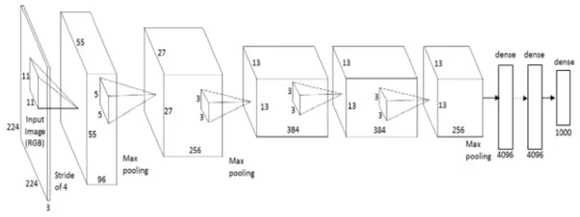
Supervised Learning
We want to predict target Y from predictors X
For very-high-dimensional data types (eg. images, sequences) we will learn about new techniques
Deep Networks
Convolutional Networks
Recurrent Networks

Slide 12
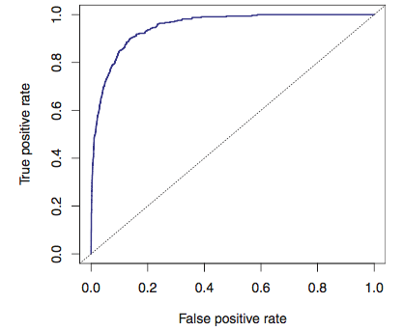

Model Evaluation Metrics
R-squared
Confusion Matrix
ROC/AUC
TP | FP
FN | TN
True Positive Rate
False Positive Rate

Slide 13
Hyperparameter Optimization (Model Selection)
A hyperparameter is a design choice we make and is not learned during model fitting
In a Random Forest model, we have to choose:
Tree Depth
Number of Trees
Fraction of variables to sample
In a K-Nearest Neighbors model, we choose:
K
In a regularized regression model (LASSO or Ridge), we choose
Regularization penalty

Slide 14
Hyperparameter Optimization (Model Selection)
We’ll encounter new hyperparameters to worry about in deep learning
Number of layers
Number of hidden nodes in each layer
Dropout rate
Convolutional kernel shapes
Number of kernels
Learning rates
Optimizers types
Many more

Slide 15
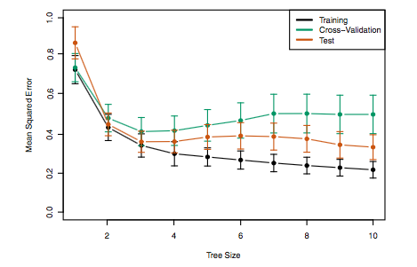
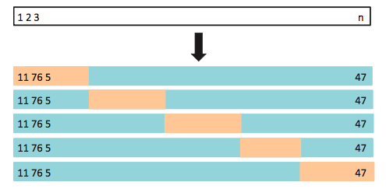
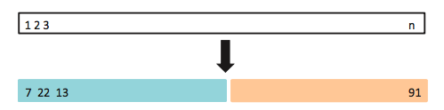
Hyperparameter Optimization (Model Selection)
It is important to critically evaluate these choices by fitting many different models. But it is more important to avoid overfitting.
Train/Test Split
K-fold Cross Validation
Leave-One-Out Validation

Slide 16
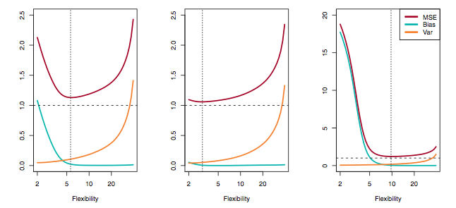
Bias Variance Tradeoff
Overfitting is problem in all modeling. It is a huge problem in deep learning.
This app https://keeganhines.shinyapps.io/bias_variance/

Slide 17
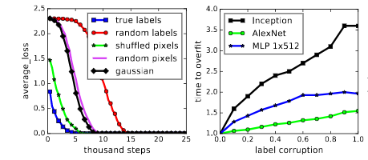
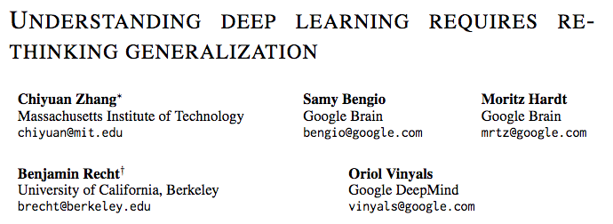
Bias Variance Tradeoff
Overfitting is problem in all modeling. It is a huge problem in deep learning.
https://arxiv.org/pdf/1611.03530.pdf
Deep networks have the “capacity” to memorize any relationships between inputs and outputs, even in extremely high-dimensional unstructured data like images and audio.

Slide 18
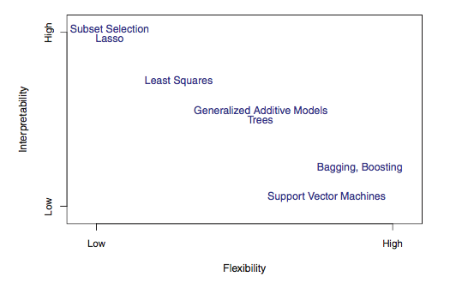
Interpretability-Accuracy Tradeoff
Most DL models are able to achieve incredible accuracy on challenging tasks
But this comes at the cost of interpretability - these models are often referred to as “black box”
There is an emerging field working on Model Explainability, we’ll touch on a few of these topics later
Deep Learning

Slide 19
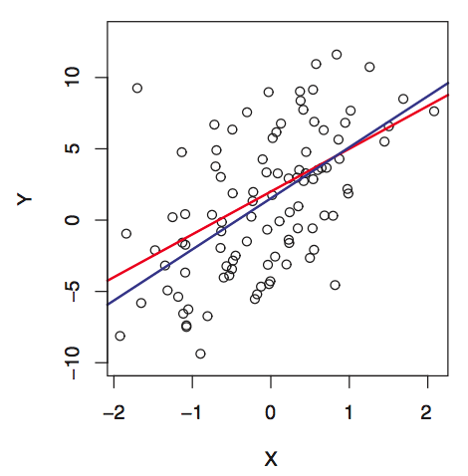

Linear Regression
The relationship between X and Y is approximately linear
There is additive Gaussian noise (epsilon)
Other assumptions: homoskedasticity, no collinearity, etc
We simply need to find the best linear model that fits the data: we need to estimate the best values of the coefficients.

Slide 20
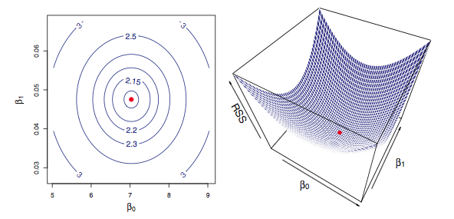
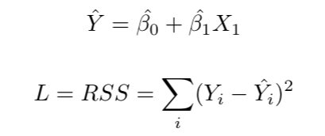
Linear Regression
Estimate the optimal coefficients by minimizing the loss function: Residual Sum of Squares
Here the loss surface is parabolic with a single global minimum.

Slide 21
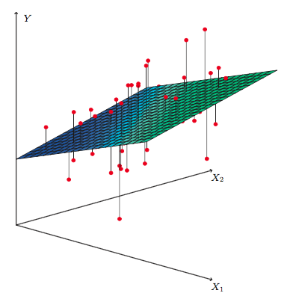
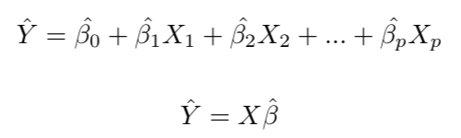
Linear Regression
Extends easily to higher dimensions. The impact of each predictor on the target variable is linear and additive
Our optimal estimator is then a hyperplane through the feature space.

Slide 22
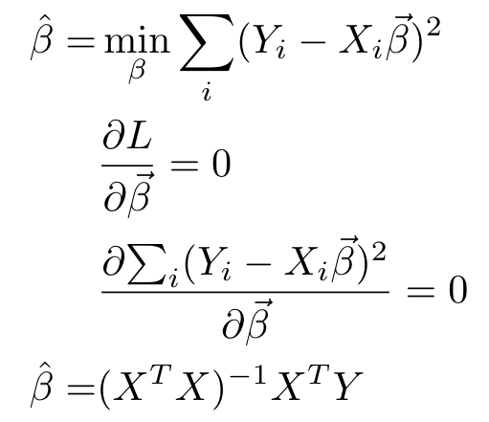
Linear Regression
General Solution:
A simple analytical solution for finding the best-fit model.

Slide 23
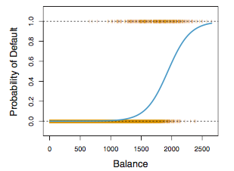


Logistic Regression

Slide 24



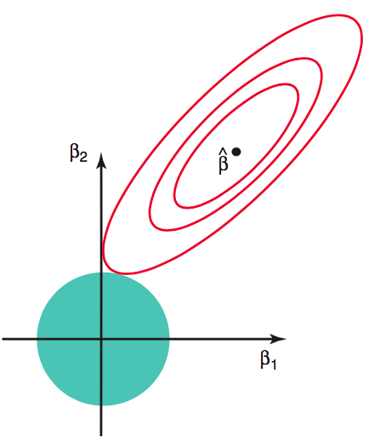
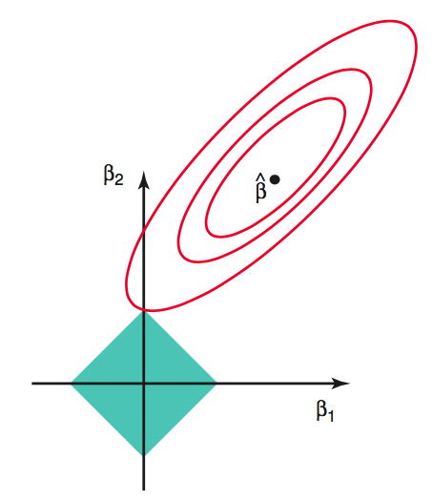
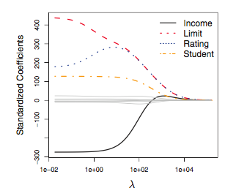
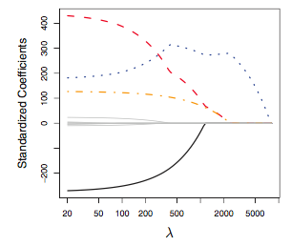
Regularization
Ridge Regression
LASSO

